Slide 1

Service Level Objective

Slide 2
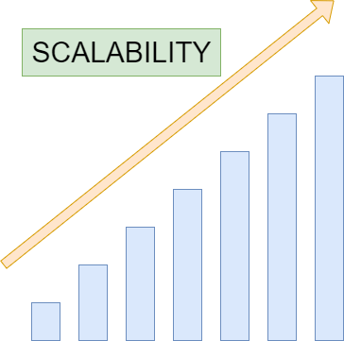

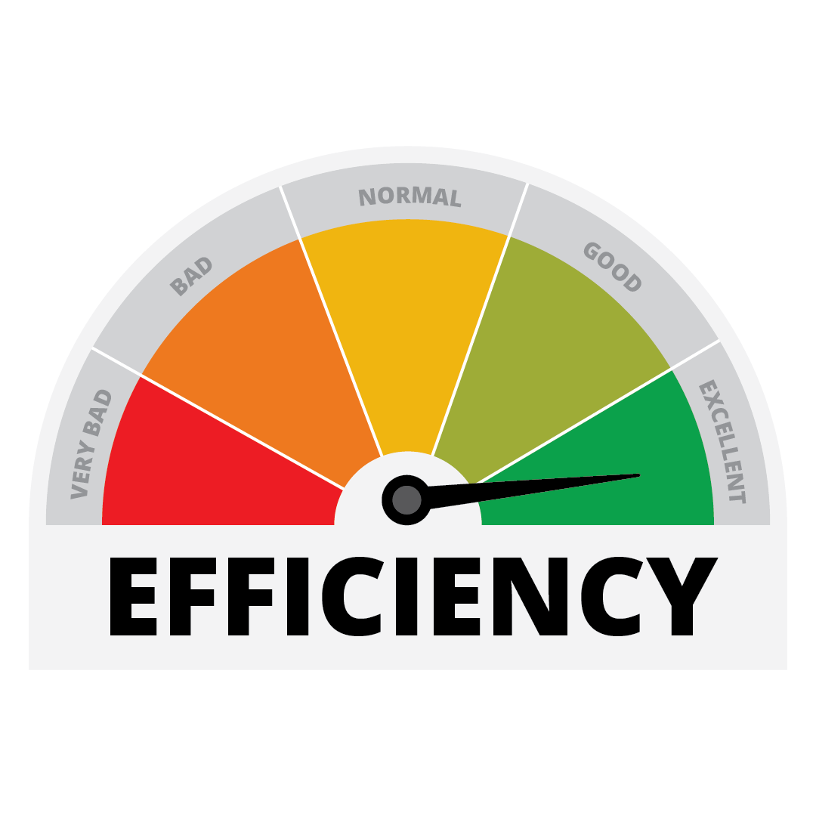
Three Pillars - SRE
RELIABILITY

Slide 3
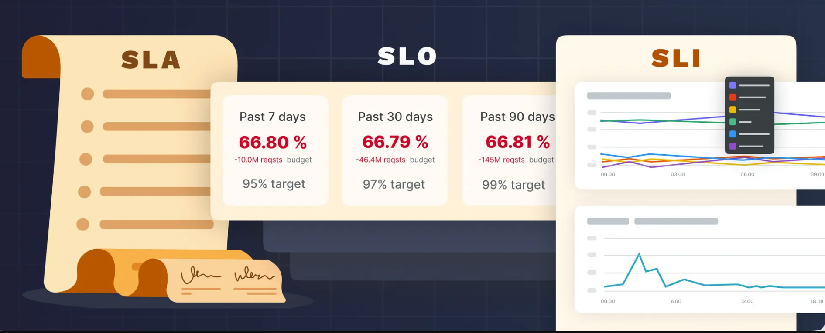
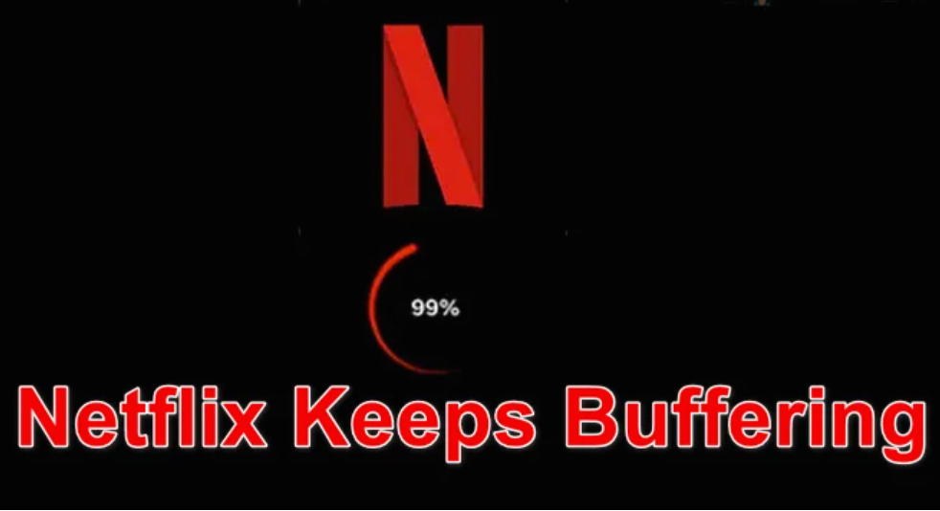
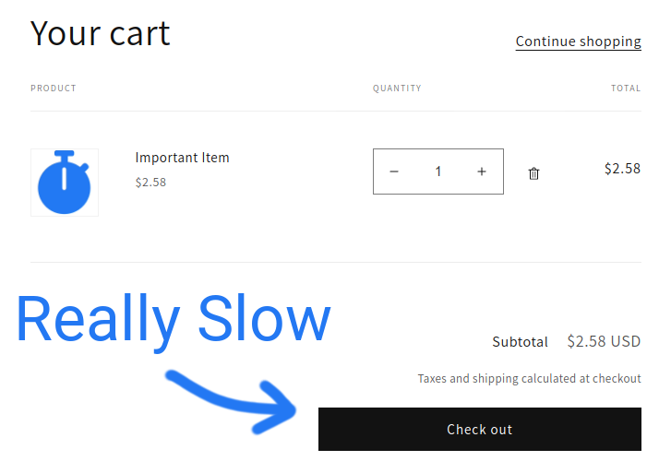

Slide 4
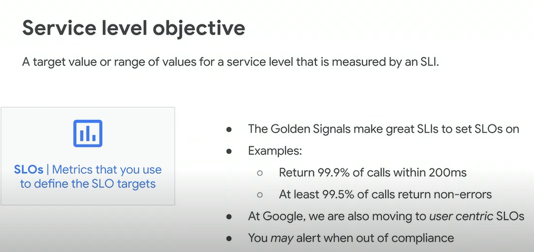
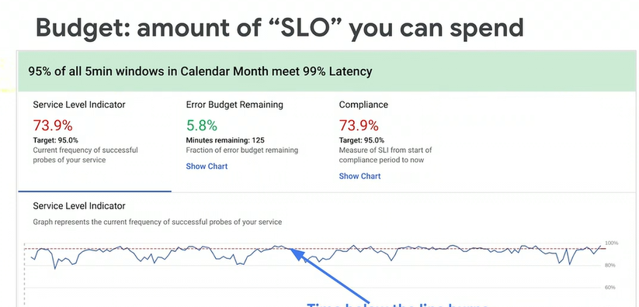
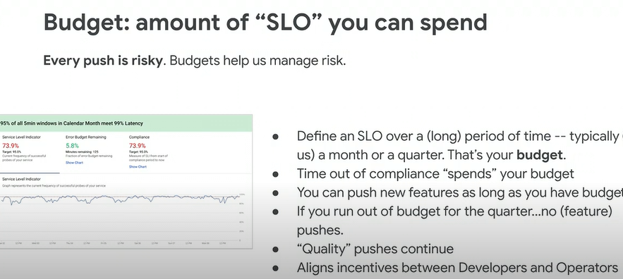
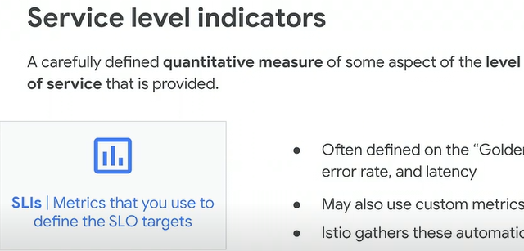

Slide 5
How to Set Meaningful Objectives
Identify Key User Journeys
Choose Metrics That Reflect User Experience
Set Realistic Targets
Test and Adjust

Slide 6
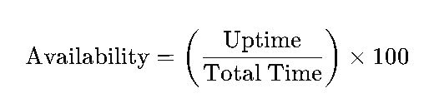
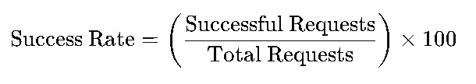
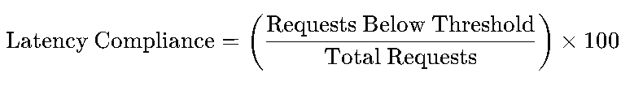
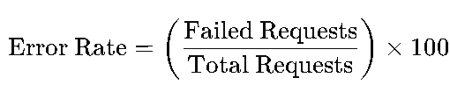
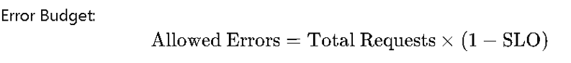
Service Level Objectives (SLOs)
1. Availability SLO : Availability refers to the percentage of time a service is operational and meeting performance expectations.
2. Success Rate SLO :This measures the proportion of successful requests compared to the total requests.
3. Latency Compliance SLO :Latency compliance measures the percentage of requests completed within a given latency threshold.
4. Error Rate SLO : This tracks the proportion of failed requests compared to total requests.

Slide 7
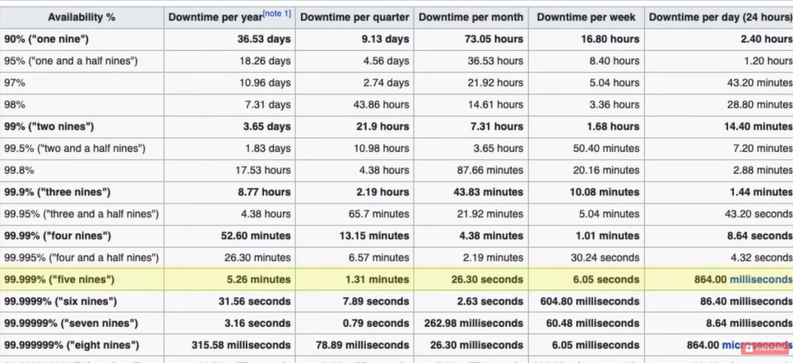

Slide 8
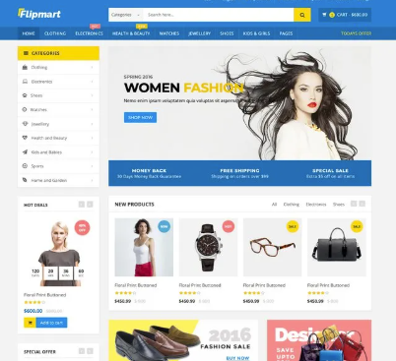

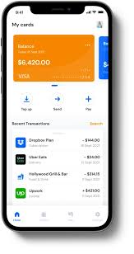
SLO in Action
SLO: 99.9% uptime for the
checkout process over a 30-day period.
SLO :99.95% uptime for streaming
during the first week of the premiere.
SLO :99.99% success rate for
transaction completion within 5 seconds.

Slide 9
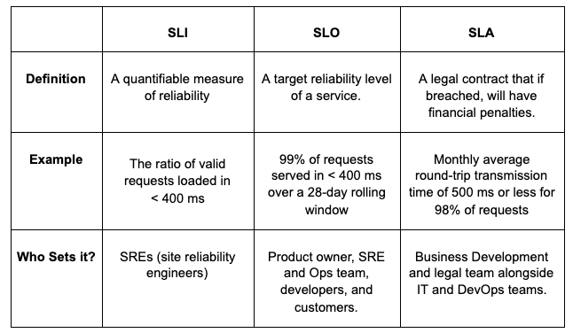

Slide 10
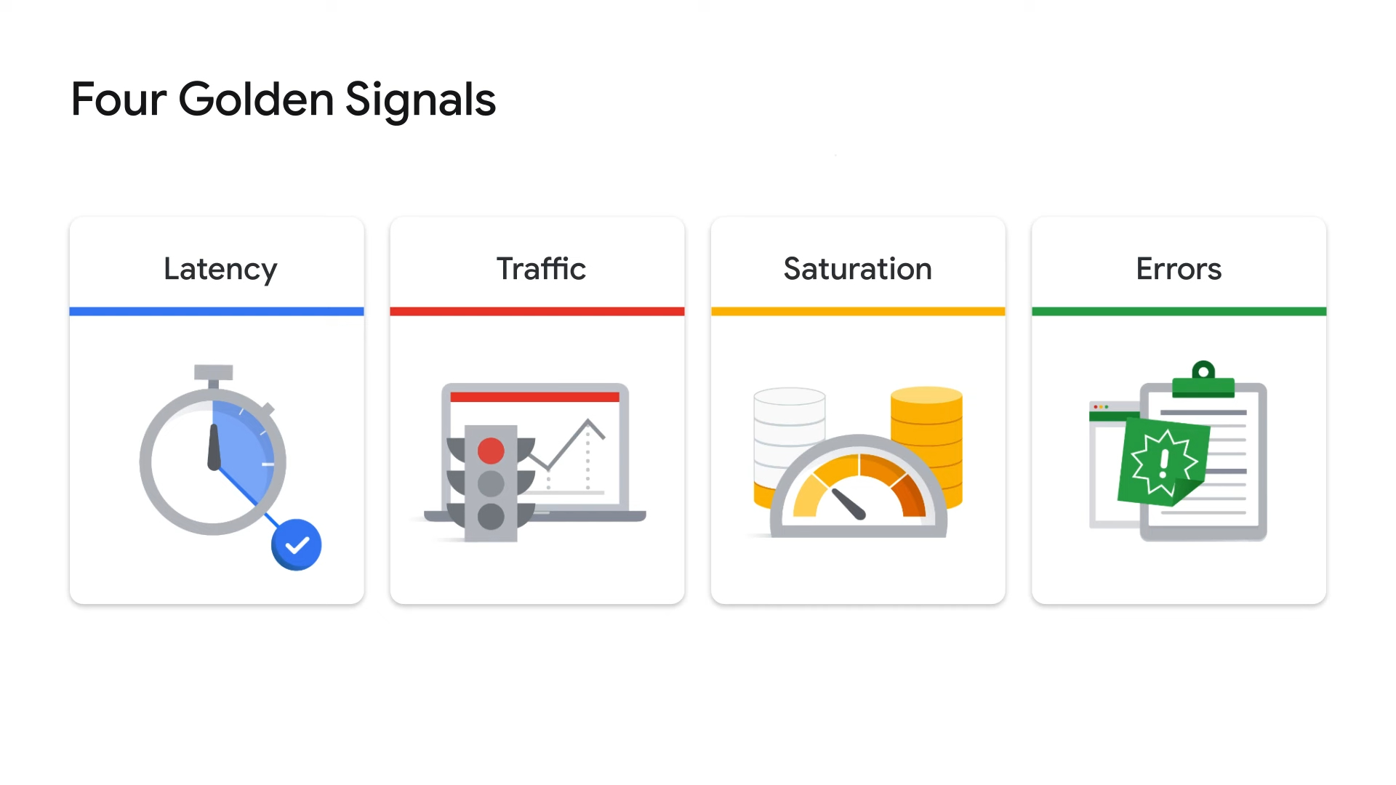

Slide 11
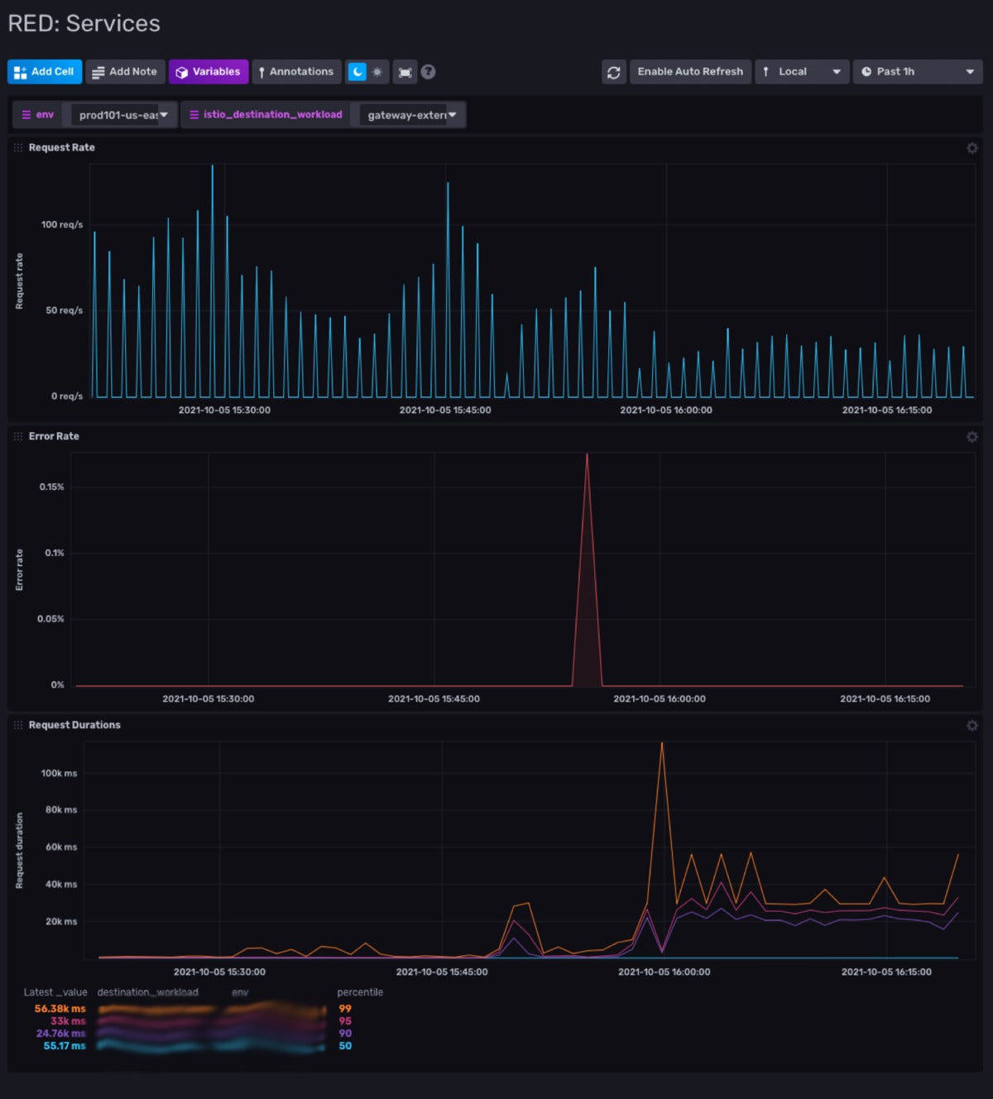

Slide 12

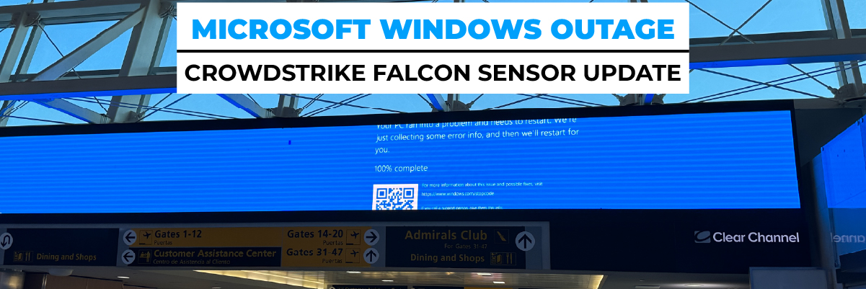
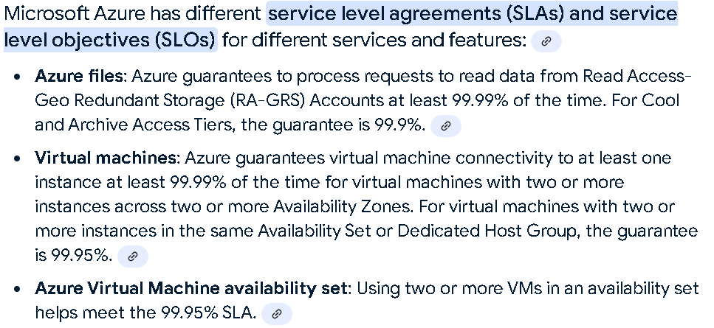
Major SLA Breach – Tech Companies
Impact:
8.5 million Microsoft Windows systems to crash globally.
$10 billion in worldwide financial damage.

Slide 13
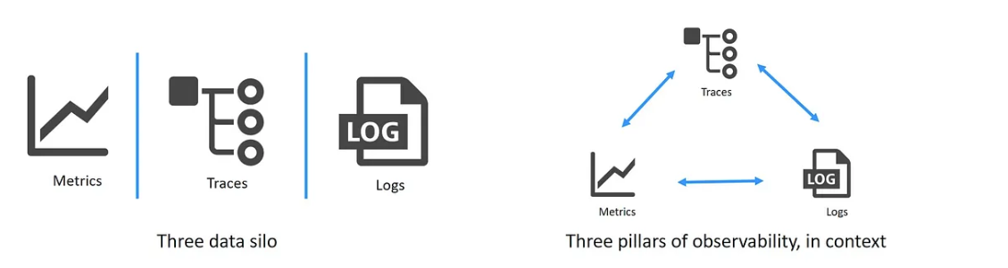
Monitoring vs Observability

Slide 14
Monitoring vs Observability
Aspect | Monitoring | Observability
Focus | Detection of issues or anomalies. | Understanding the internal state and behavior of a system.
Goal | Ensure the system is performing within set thresholds. | Gain insights and diagnose the root causes of issues.
Data | Collects specific predefined metrics (e.g., CPU usage, error rate). | Uses metrics, logs, and traces to allow exploration.
Granularity | Focuses on high-level indicators (e.g., uptime, CPU load). | Provides deep, detailed insights into system behavior.
Proactive vs. Reactive | Often reactive—alerts you when something is wrong. | Proactive and reactive—helps you investigate and understand what went wrong.
Example | Alert if memory usage is > 90%, or if response time > 2s. | Investigating why a request failed or why response time increased.
Primary Use | Health checks, performance thresholds, uptime monitoring. | Deep exploration, debugging, root cause analysis.

Slide 15
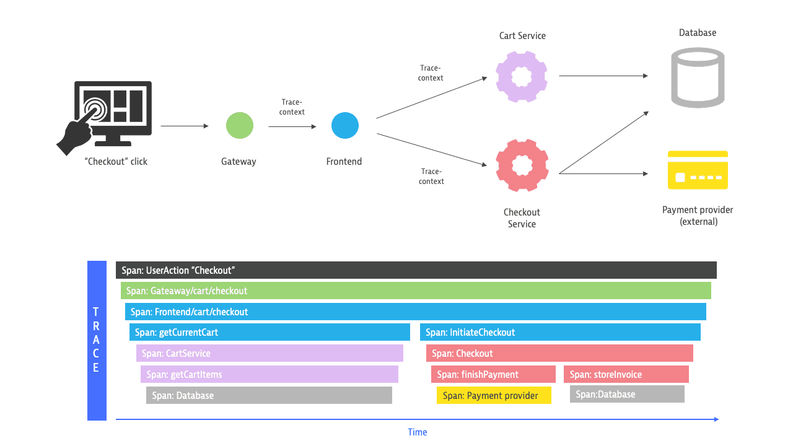

Slide 16
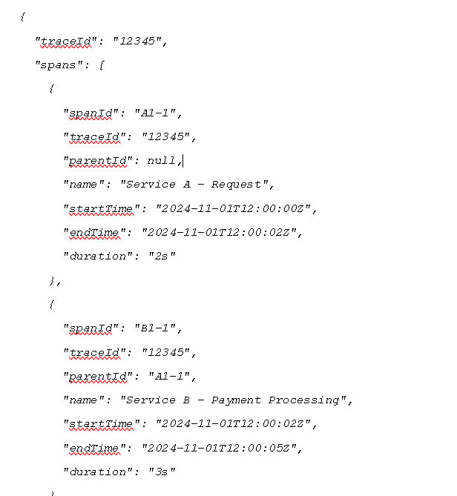
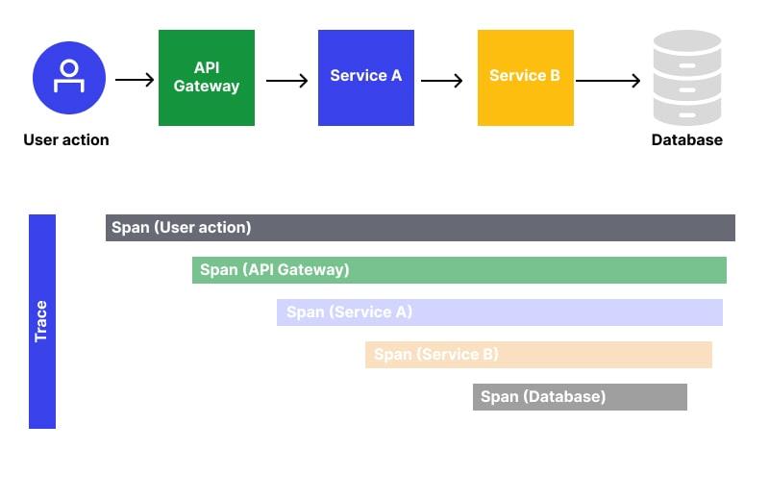

Slide 17
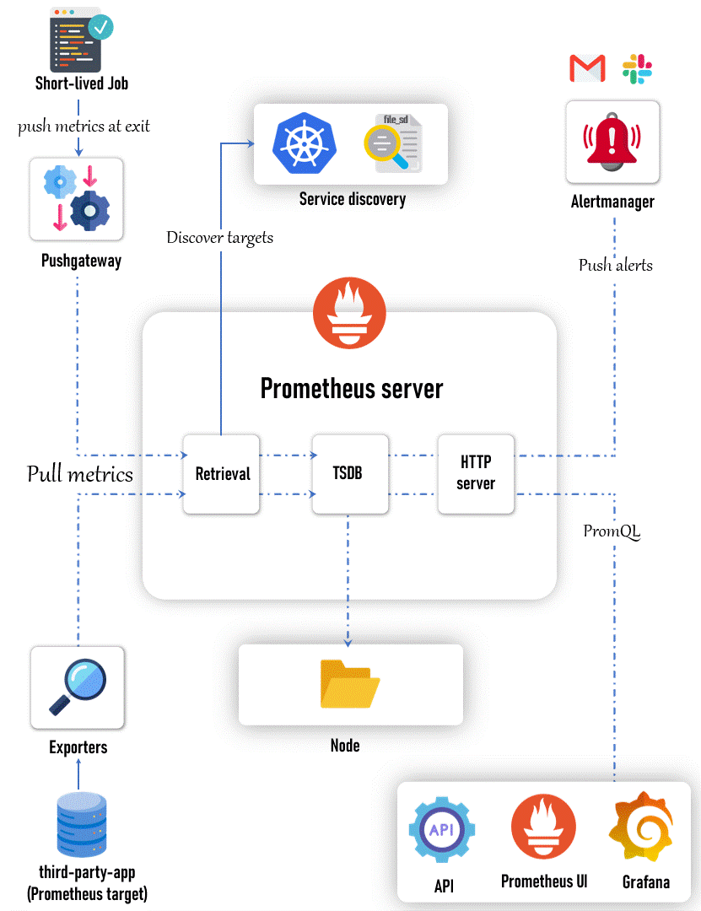

Slide 18
